Slide 1
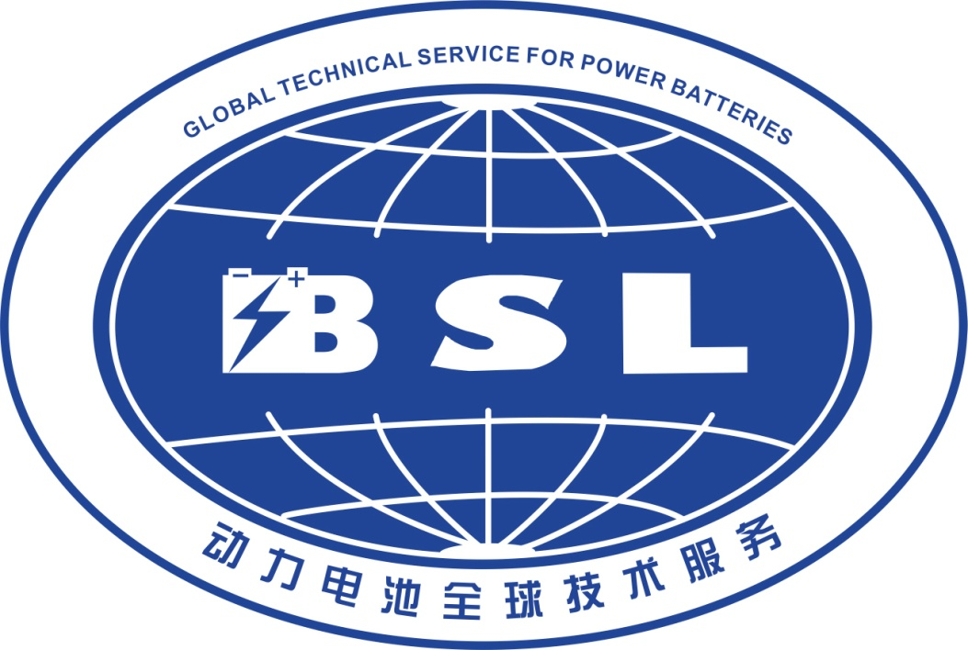

Development Status of Lightweight Power Lithium lon Bettery Technology
—Lithium Lron Phosphate
Yang Xiaolin
Notes:
各位尊敬的评审专家，下午好，我叫孙延先。下面由我来汇报申报资料。

Slide 2


1. Basic concept 2. Key technical route 3. Lithium iron phosphate advantage 4. Electrical performance and safety performance 5. The Development Trend and Application of the Future
catalogue：
1.Basic concept of Lithium Ion Battery
2. Key technical route of light power battery
2.1. Electric core-four main materials and process route 2.2. PACK-Key process and technical route
3. Advantages of lithium iron phosphate
4. Electrical and safety properties of lithium ferrophosphate
5. Development trend and Application of Light Power in the Future
Notes:
我的汇报分如下五个部分

Slide 3
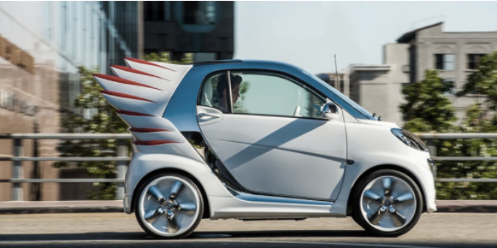
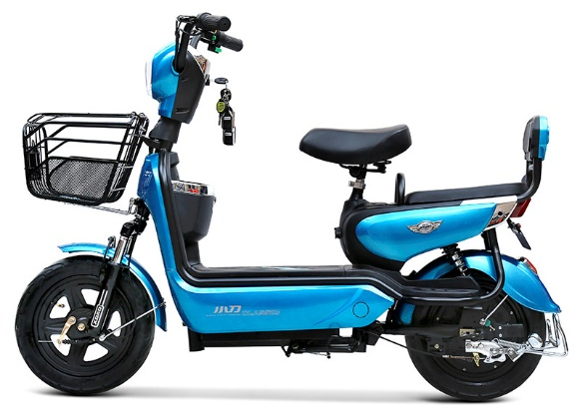
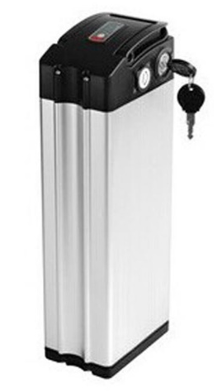
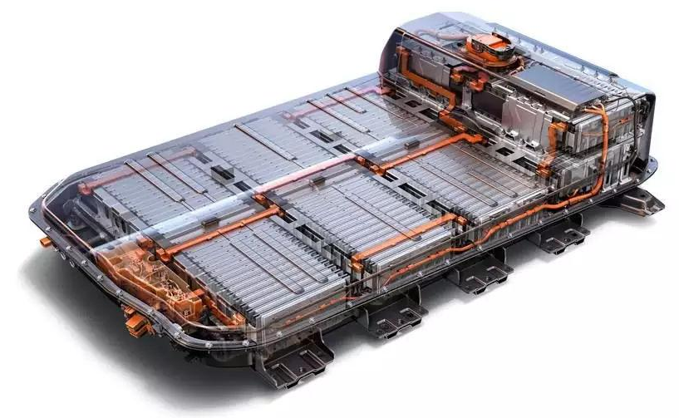
1. 基本概念 2. 关键技术路线 3. 磷酸铁锂优势4. 电性能及安全性能 5. 未来发展趋势及应用
Lithium ion battery concept：
The power battery refers to a device which is configured to be used on an automobile, can store electric energy and can be recharged, and provides energy for driving the automobile to drive.
concept
classify
Power batteries include lithium-ion power batteries, metal hydride nickel power batteries and supercapacitors, excluding lead-acid batteries
。
apply
At present, lithium ion power battery system is the main application of new energy vehicle power battery in our country.
The power battery is compared with the heart of a new energy automobile because of the key of the power battery in the application field of the automobile.
importance

Slide 4
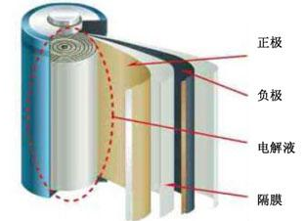
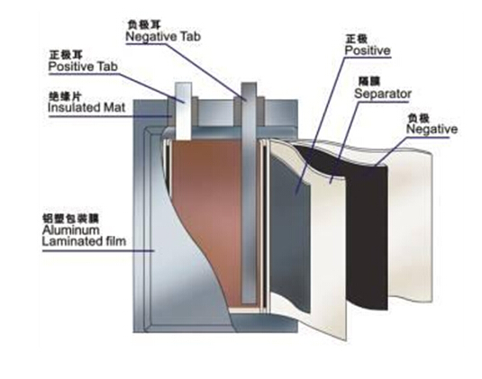
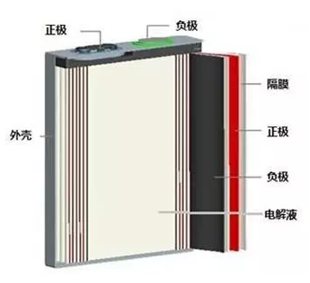
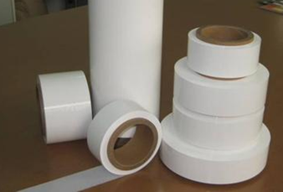
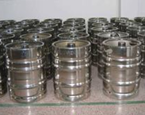
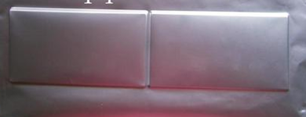
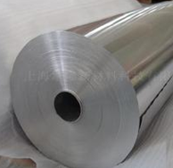
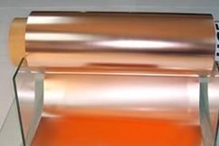
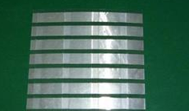
1. 基本概念 2. 关键技术路线 3. 磷酸铁锂优势4. 电性能及安全性能 5. 未来发展趋势及应用
Lithium ion battery structure
Three structures of Lithium Ion Battery
Positive material: NCA, NMC, LMO, LFP, LCO, etc.;
negative electrode material: graphite, Si-C, SiOx, LTO, etc.;
conductive agent: SP, KS-6, CNT, graphene, etc.;
Diaphragm: PP, PE, non-woven fabric;
Electrolyte: organic solution of LiPF6,LiAsF6 etc;
packaging: aluminum-plastic film and aluminum shell;
current collector: the negative is generally an aluminum foil; the negative electrode is generally a copper foil;
tab: positive aluminum pole ear, negative copper nickel-plated tab;
Soft Roll
Circular column
Aluminum shell
Aluminum plastic film
Current collector (aluminum+ copper)
separator
electrolyte
era of the plate

Slide 5
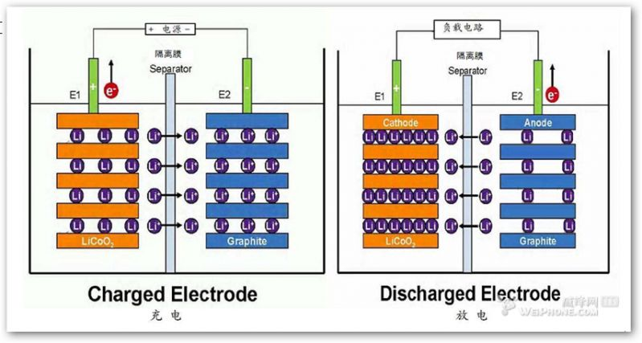

1. 基本概念 2. 关键技术路线 3. 磷酸铁锂优势4. 电性能及安全性能 5. 未来发展趋势及应用
The principle of Li-ion battery
Charging process: Power charges the battery, at which point the electron e on the positive electrode runs from the external circuit to the negative electrode, the positive lithium-ion Li "jumps" from the positive electrode into the electrolyte," climbs "through the winding hole in the diaphragm," swims" to the negative electrode, and combines with the electron that has been running long ago.
Discharge process: battery discharge, when the electron e on the negative electrode runs from the external circuit to the positive electrode, the positive lithium ion Li "jumps" into the electrolyte from the negative electrode, "climbs" through the curved hole in the diaphragm, "swims" to the positive pole, and combines with the electrons that have been running for a long time.

Slide 6

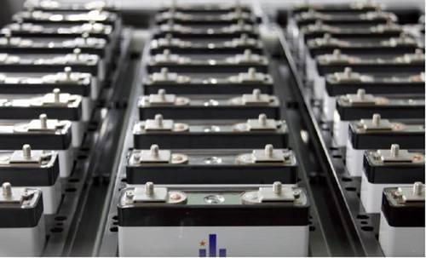
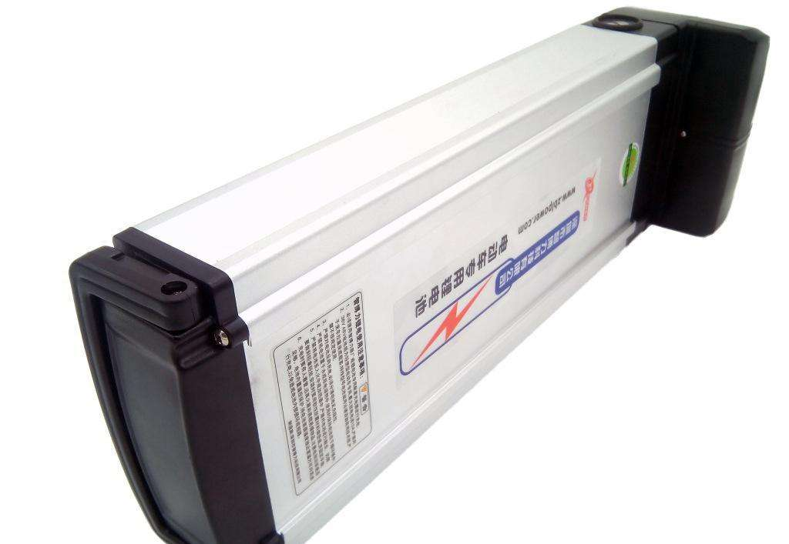
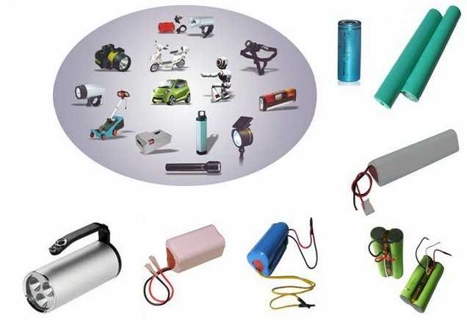
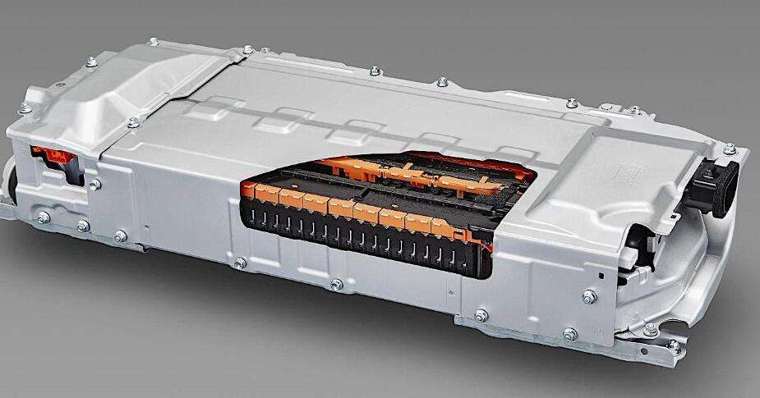
1. 基本概念 2. 关键技术路线 3. 磷酸铁锂优势4. 电性能及安全性能 5. 未来发展趋势及应用
Application of Lithium Ion Battery
EBlithium battery system
Arrangement mode of power core for aluminum shell
EV lithium battery system
lithiun battery and others

Slide 7
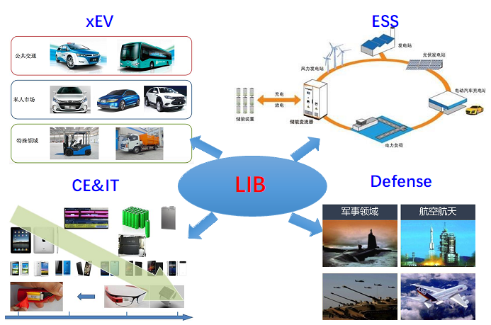
1. 基本概念 2. 四大主材 3. 磷酸铁锂优势4. 电性能及安全性能 5. 未来发展趋势及应用
Application of Lithium Ion Battery

Slide 8

1. 基本概念 2. 关键技术路线 3. 磷酸铁锂优势4. 电性能及安全性能 5. 未来发展趋势及应用
目录：
1.Basic concept of Lithium Ion Battery
2. Key technical route of light power battery
2.1. Electric core-four main materials and process route 2.2. PACK—关键工艺技术路线
3. 磷酸铁锂优势
4. 磷酸铁锂电性能及安全性能
5. 轻型动力未来发展趋势及应用
Notes:
我的汇报分如下五个部分

Slide 9
1. 基本概念 2. 关键技术路线 3. 磷酸铁锂优势4. 电性能及安全性能 5. 未来发展趋势及应用
lithium ion battery material industry chain
lithium ion battery material industry chain
Nickel, manganese, cobalt and other mineral resources
Lithium ore
Graphite ore
Upstream:
raw materials
Middle reaches: core material
Cathode material
electrolyte
Negative electrode material
separtor
else material
Core Manufacturing and PACK Assembly
New energy vehicle
Energy storage system
Downstream: application
phone and other digital products
electromotion
electrotachyscope

Slide 10

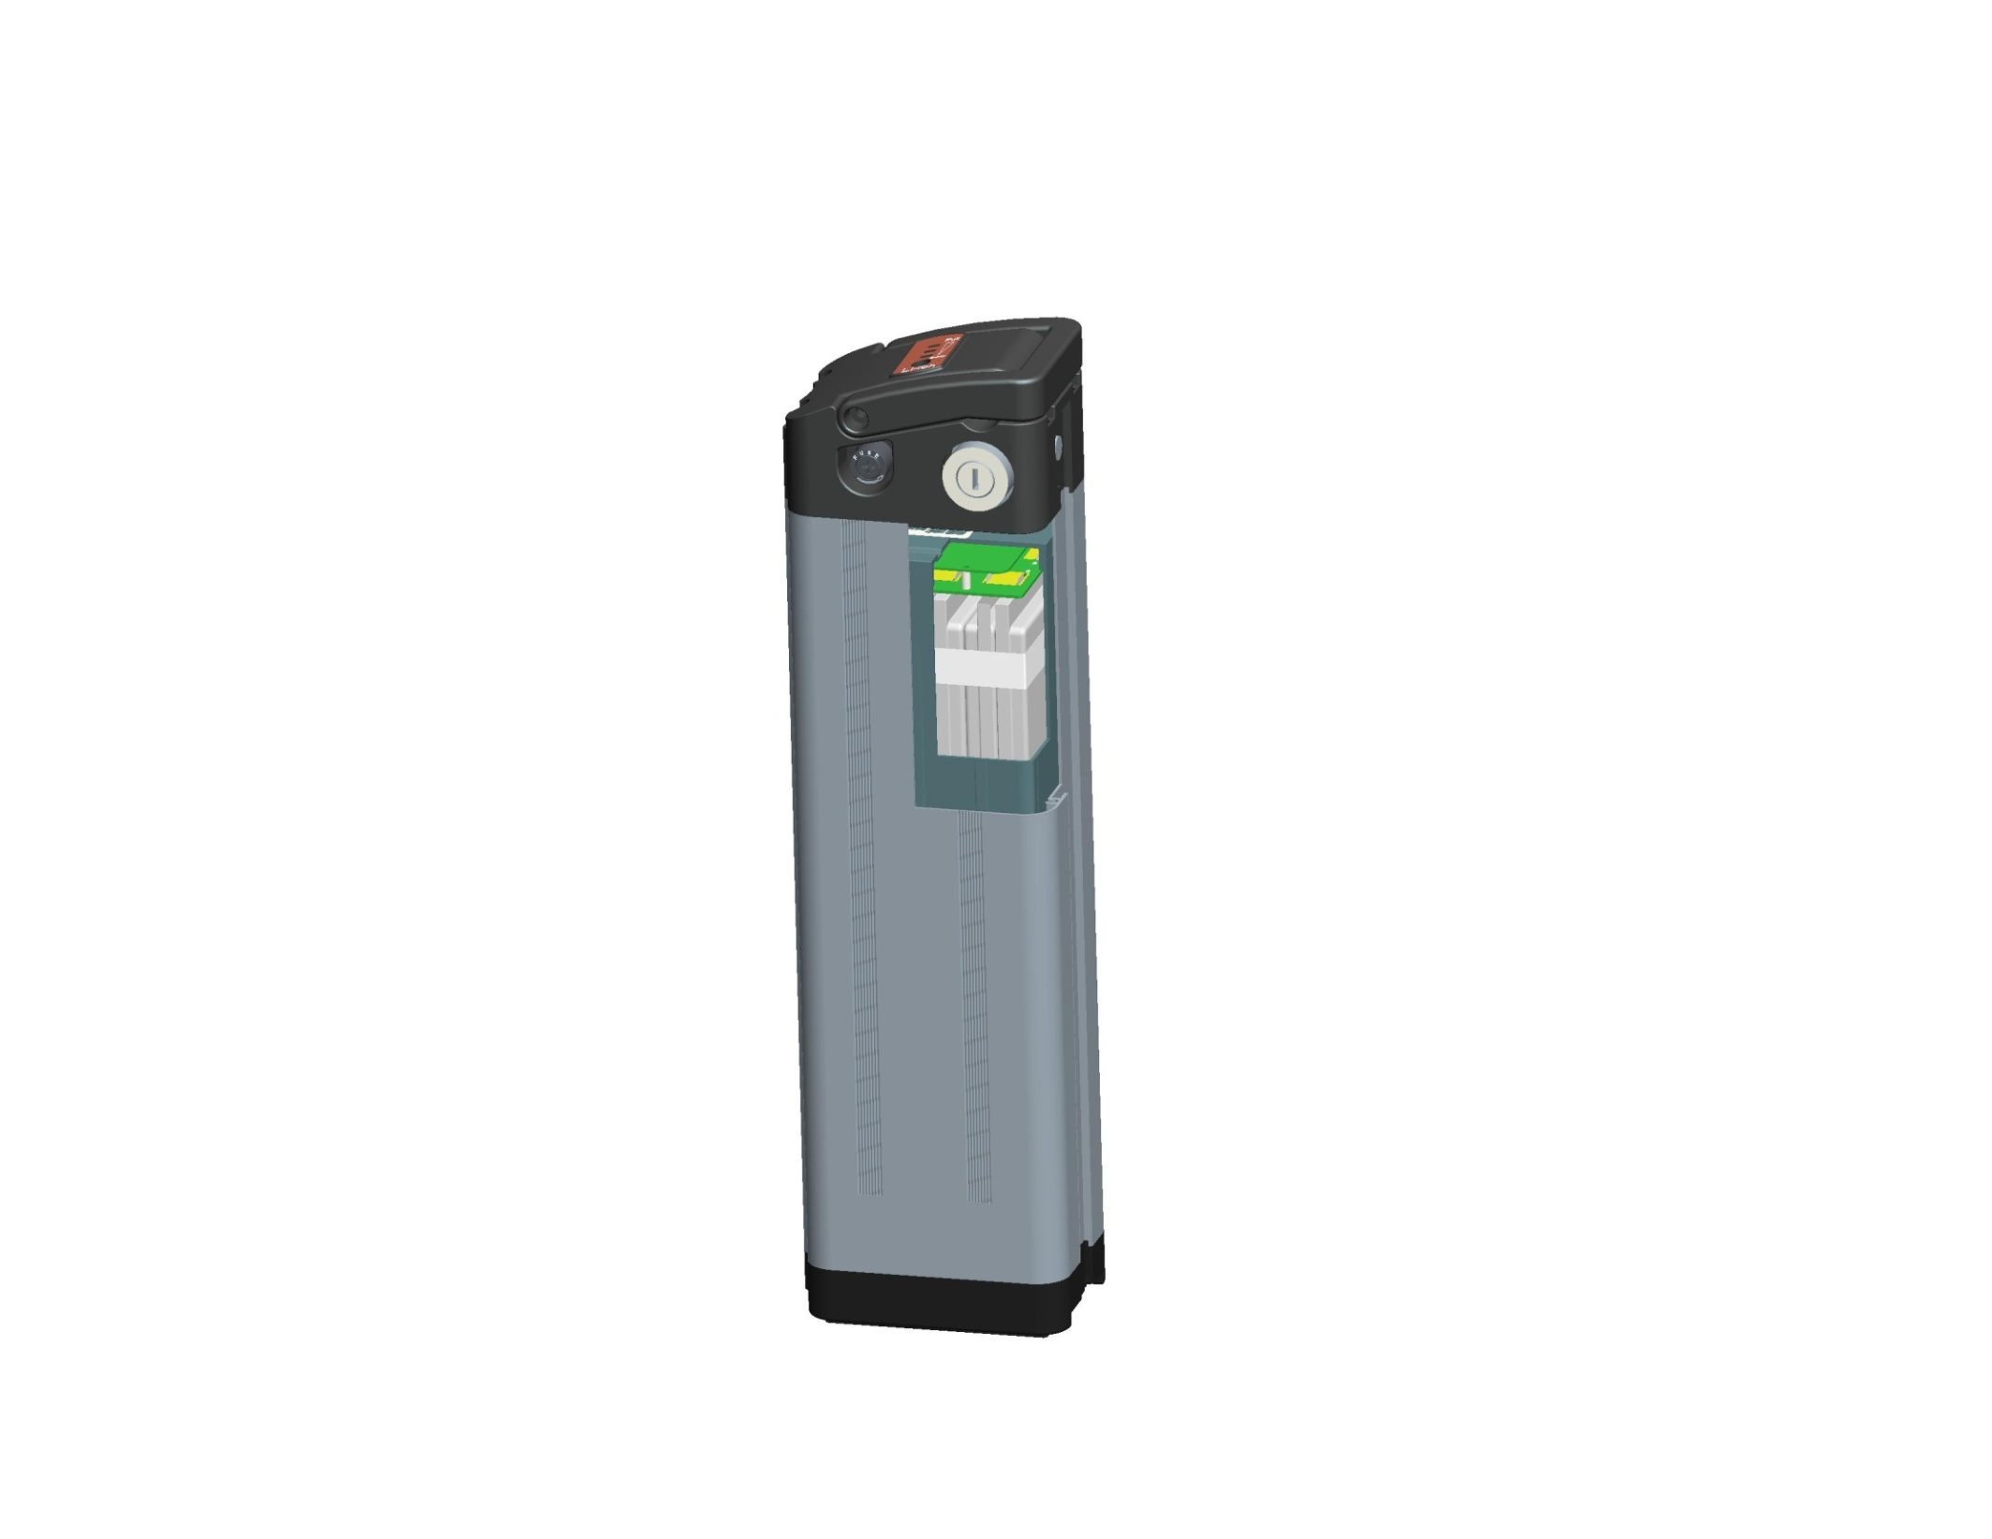
1. 基本概念 2. 关键技术路线 3. 磷酸铁锂优势4. 电性能及安全性能 5. 未来发展趋势及应用
lithium ion battery material industry chain
The structure of typical battery
Electric quantity indication
handle
lock
container
Insurance seat
BMS）
keysets
Soft package core
Electric core sheath
Battery container (aluminum bucket)
Battery case base

Slide 11
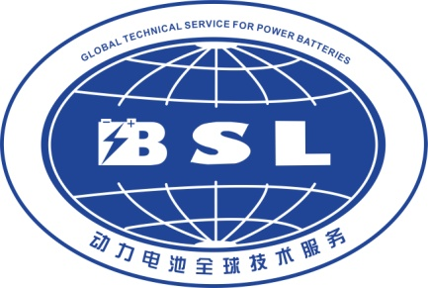
1. 基本概念 2. 关键技术路线 3. 磷酸铁锂优势4. 电性能及安全性能 5. 未来发展趋势及应用
Four key Materials for Lithium Ion batteries
Four key Materials of Lithium Ion Battery and their functions
positive material
negative material
seperator
electrolyte
During charging and discharging, the oxidation-reduction potential
The change is small and the stability is good.
Particle Morphology and Collocation
Higher electron and ion conductivity
The charging and discharging performance of large current is good
In the process of charge and discharge, the redox potential changes little, the chemical stability is good, and the reaction with electrolyte is small.
Good surface structure, the formation of good SEI film
High electron and ion conductivity, high current charge and discharge performance
Ceramic coated diaphragm
Ion conductor coated diaphragm, high voltage resistant diaphragm, solid electrolyte diaphragm, etc.
Others
New Lithium Salt and its collocation
SEI film forming additive
Have been filled with additives
Anti-collecting fluid corrosion additive 5. Other additives

Slide 12
1. 基本概念 2. 关键技术路线 3. 磷酸铁锂优势4. 电性能及安全性能 5. 未来发展趋势及应用
Four key Materials-cathode Materials
The characteristics of positive active substances require:
1. The specific capacity is large, the positive electrode material is required to have a low relative molecular weight, and the host structure thereof is capable of inserting a large amount of Li;
2. The operating voltage is high, and the Gibbs free radical negative value of the system discharge reaction is large;
3. the rate performance is good, Li is required to have a higher diffusion rate inside the electrode material and on the surface;
4. The cycle life of the material is long, and the structure change of the material during the insertion/ removal process of Li is as small as possible;
5. the safety is good, and the material has higher chemical stability and thermal stability;
6. easy to prepare, Is environment-friendly and low in price.

Slide 13
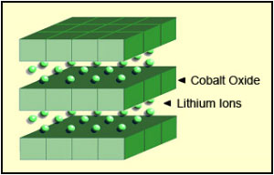
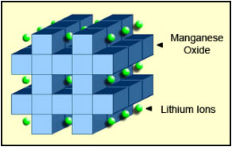
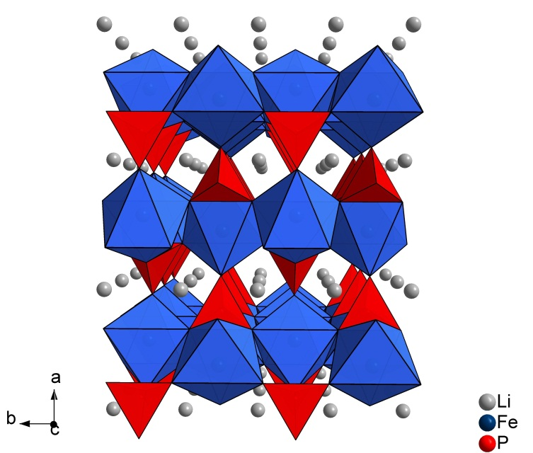
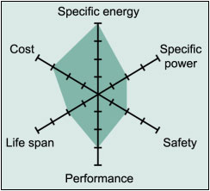
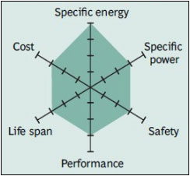
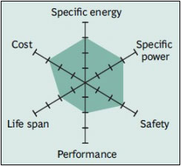
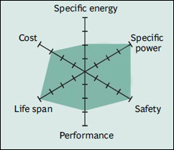
1. 基本概念 2. 关键技术路线 3. 磷酸铁锂优势4. 电性能及安全性能 5. 未来发展趋势及应用
Cathode material different cathode material
LCO
NCM
LMO
LFP
Advantages: layered structure, two-dimensional movement of ions, disadvantages: poor life, poor safety;
Advantages: layered structure, two-dimensional movement of ions, high energy density, disadvantages: high price, poor safety;
Advantages: spinel structure, three-dimensional movement, cheap;
disadvantages: low energy density, good safety;
Advantages: olivine structure, one-dimensional movement, cheap;
disadvantages: low platform voltage, the best safety;

Slide 14
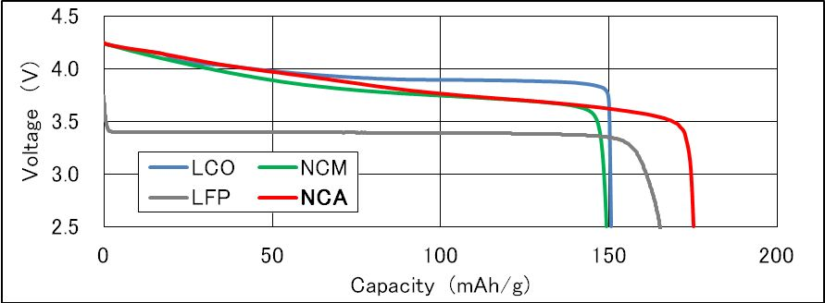
Comparison of discharge curves of positive active substances:
1. 基本概念 2. 关键技术路线 3. 磷酸铁锂优势4. 电性能及安全性能 5. 未来发展趋势及应用
Comparison of discharge Curves of different cathode Materials
Cathode Type | Chemistry | Example Metal Portions | Example Use
NCA | LiNiCoAlO₂ | 80% Nickel,15% Cobalt,5% Aluminum | Tesla Model S
LCO | LiCoO₂ | 100% Cobalt | Apple iPhone
LMO | LiMn₂O₄ | 100% Manganese | Nissan Leaf
NMC | LiNiMnCoO₂ | 33.3% Nickel,33.3% Manganese,33.3% Cobalt | Tesla Powerwall
LFP | LiFePO₄ | 100% Iron | Starter batteries

Slide 15
1. 基本概念 2. 关键技术路线 3. 磷酸铁锂优势4. 电性能及安全性能 5. 未来发展趋势及应用
Performance comparison of different kinds of Lithium Ion batteries
NAME | lithium cobaltate | lithium manganate | Lithium iron phosphate | Lithium nickel cobalt manganate
chemical reaction | LiCoO₂ | LiMn₂O₄ | LiFePO₄ | Li(Ni_{x}Co_{y}Mn_{z})O₂
Average voltage (with graphite) | 3.7V | 3.7V | 3.2V | 3.6V
crystal structure | stratiform | spinel | olivine | stratiform
cycle life | 500-1000 | 500–1000 | 2000–6000 | 800–2000
running temperature | Average | Average | Good | Good
cell energy density | 180–240Wh/kg | 130–160Wh/kg | 130–160Wh/kg | 180–280Wh/kg
power | 1C | 10C, impulse | 35C ,continuation | 6C
safety | Bad | Good | Excellent | Good
Thermal runaway start temperature | 150°C (302°F) | 250°C (482°F) | 270°C (518°F) | 210°C (410°F)
Commercial period | 1994 | 2002 | 1999 | 2003
Research and production institutions | Samsung, LG, Sony, Sanyo | NEC, Samsung, Hitachi | UT, QH, MIT，A123, Valence | Samsung, LG, Sony, Sanyo, Nissan Motor
Main application fields | 3Celectronic product | Electric tools, medical machines | EV、EB and energy storage | EV、EB3CElectronic product, electric tool, medical machine

Slide 16
1. 基本概念 2. 关键技术路线 3. 磷酸铁锂优势4. 电性能及安全性能 5. 未来发展趋势及应用
Four key Materials-cathode Materials
The characteristics of negative active substances require:
1. The embedded stripping Li reaction has a low redox potential to meet the higher output voltage of the battery;
2.In the process of Li embedding and stripping, the electrode potential changes little to ensure that the voltage fluctuation is small during charge and discharge.
3.Li embedded stripping process has good structural stability and chemical stability to ensure the higher cycle and safety of the battery;
4. It has a high reversible specific capacity;
5. Good lithium ion and electronic conductivity to obtain better rate and low temperature performance;
6. The preparation process is simple, easy to scale, and the cost of manufacture and use is low.
7.The environment is friendly and the resources are rich.

Slide 17
1. 基本概念 2. 关键技术路线 3. 磷酸铁锂优势4. 电性能及安全性能 5. 未来发展趋势及应用
Four key Materials-negative electrode Materials
Crystal graphite
Classification of negative electrode materials:
natural graphite
graphitized carbon
Microcrystal graphite
artificial graphite
MCMB
agraphitic carbon
Carbon anode material
Easy graphitization carbon (soft carbon)
Negative electrode material for lithium ion battery
nanophase materials
Difficult graphitization carbon (hard carbon)
Non-carbon anode material
Alloy material
Metals and their oxides

Slide 18
1. 基本概念 2. 关键技术路线 3. 磷酸铁锂优势4. 电性能及安全性能 5. 未来发展趋势及应用
Negative electrode material - lithium insertion characteristics of graphite.
1. Lithium intercalation potential is low and flat, which can provide high and stable working voltage for lithium ion, and the lithium insertion capacity is between 0.2 V and 0 V.
2. the theoretical capacity of LiC6 is 372 mAh/g;
3. which is poor compatibility with organic solution and easy to occur solvent co-insertion, thus reducing the performance of lithium insertion.
The insertion reaction of lithium is generally carried out from the rhomboid position (that is, the end face, Z profile and armchair surface), because lithium cannot pass through the complete ink base surface. However, if there are defects in the base surface, such as micropores, lithium can also be inserted through the base surface.

Slide 19
1. 基本概念 2. 关键技术路线 3. 磷酸铁锂优势4. 电性能及安全性能 5. 未来发展趋势及应用
Mechanism of Lithium Storage by Graphite as anode material
1. It can be seen from the charge-discharge curve that the potential decreases rapidly at the beginning of charging, and a small platform appears at about 0.8V, which is considered to be the decomposition of electrolyte on the surface of graphite electrode to form insoluble SEI film.
2, the curve between 0.25V~0.005V is flat, and most of the capacity is in this potential range. There is almost no capacity above 0.25 V, that is, the reversible capacity is in the range of 0.25V~0.005V potential.
3, when the SEI film reaches a certain thickness, the film has insulation effect on electrons, only ion conductivity, which can prevent the electrolyte from further reduction, so from the second cycle, the charge-discharge efficiency is close to 100%.
Charge-discharge Curve of Graphite electrode

Slide 20
1. 基本概念 2. 关键技术路线 3. 磷酸铁锂优势4. 电性能及安全性能 5. 未来发展趋势及应用
negative electrode material graphite negative pole
difference between artificial graphite and natural graphite
project |  | Artificial graphite | natural graphite | evaluation methodology | remarks
raw and processed material |  | Coal tar, petroleum coke, calcined coke, asphalt, etc. | The natural graphite ore is mined, floated, selected, | / | According to the origin of the raw materials, the performance will be different.
surface |  | Dark, dark. | Iron black or steel gray, soft, shiny and greasy with metallic luste | Visual inspection, hand touch | /
pattern | single | block, sheet, needle, or irregular shape | block, sheet, spherical or quasi-spherical | Scanning electron microscope (SEM) test, surface, profile | /
 | many | Petal, globular, popcorn, etc. | Petal, globular, popcorn, etc.
degree of graphitization |  | The degree of crystallization is slightly lower, Graphitization degree is often less than 93%（d002:0.336-0.337nm） | high degree of crystallinity, the degree of graphitization is often above 94%.（d002:0.3354-0.3359nm | (XRD) Test of X-ray diffractomete | /
crystal structure |  | hexagonal system (ABAB... sequence arrangement) no diamond-shaped peak | Hexagonal crystal system and rhombohedral crystal system (ABAB). Sequence arrangement) with rhomboid peak

Slide 21
1. 基本概念 2. 关键技术路线 3. 磷酸铁锂优势4. 电性能及安全性能 5. 未来发展趋势及应用
Negative electrode material-soft carbon, hard carbon
Soft carbon: the graphitized carbon is the amorphous carbon that can be graphitized at a high temperature above 2500 DEG C. The crystallinity of the soft carbon (that is, the degree of graphitization) is low, the grain size is small, the crystal plane spacing (d002) is large, the compatibility with the electrolyte is good, the irreversible capacity of the first charge and discharge is high, the output voltage is low, and the potential of the charging and discharging platform is not obvious. Common soft carbon has petroleum coke, needle coke, carbon fiber, carbon microsphere, etc.
Hard carbon: refers to the carbon that is hard to graphitize. It is the pyrolytic carbon of the high molecular polymer. The high temperature of the carbon at above 2500 ℃ is also difficult to graphitize. Common hard carbon has resin carbon (such as phenolic resin, epoxy resin, polyfurfuryl alcohol PFA-C, etc.)
graphene
Soft carbon
Hard carbon

Slide 22
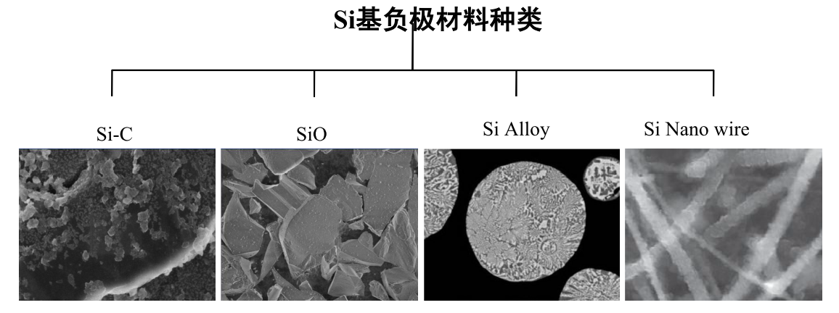
1. 基本概念 2. 关键技术路线 3. 磷酸铁锂优势4. 电性能及安全性能 5. 未来发展趋势及应用
Negative electrode material-silicon negative electrode
The theoretical capacity of silicon is as high as 4200mAh ·g, which is more than ten times of the 372mAh/g of graphite.
In the process of charge and discharge, the lithium removal reaction of silicon will be accompanied by a large volume change (> 200%), resulting in the destruction of material structure and mechanical powdering, resulting in the separation of electrode materials and collector materials, and then the loss of electrical contact, resulting in the rapid attenuation of capacity and the deterioration of cycle performance. Due to the severe volume effect, the SEI film on silicon surface is in the dynamic process of destruction and reconstruction, which results in continuous lithium ion consumption and further affects the cycle performance.

Slide 23
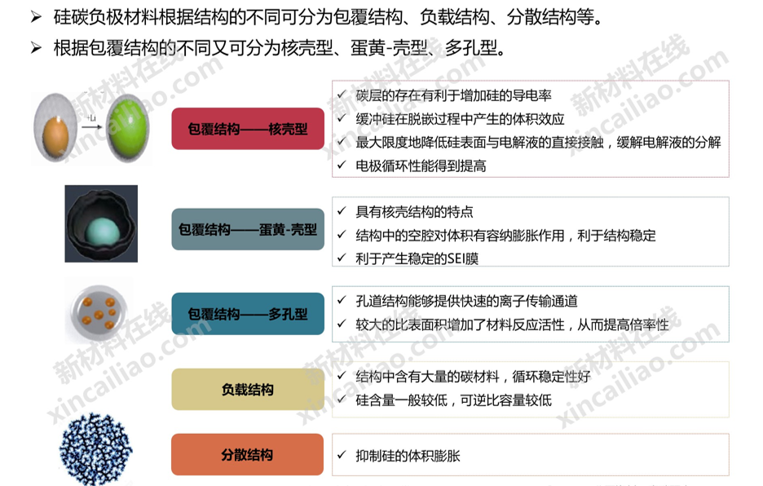
1. 基本概念 2. 关键技术路线 3. 磷酸铁锂优势4. 电性能及安全性能 5. 未来发展趋势及应用
negative electrode material graphite negative pole
The silicon-carbon cathode material can be divided into a coating structure, a load structure, a dispersion structure and the like according to different structure.
According to the different coating structure, it can be divided into core-shell type, egg yolk-shell type and porous type.
The presence of the carbon layer is beneficial to increasing the conductivity of the silicon.
The volume effect of the buffer silicon in the deintercalation process minimizes the direct contact between the silicon surface and the electrolyte, and the decomposition of the electrolyte is relieved.
The electrode cycle performance is improved
Coated structure-core-shell type
encapsulated yolk-shell type
It has the characteristics of core-shell structure.
The cavity in the structure has the effect of accommodating expansion on the volume, which is beneficial to the stability of the structure.
Conducive to the production of stable SEI films
Coated structure - porous type.
The pore structure can provide a fast ion transport channel.
The larger specific surface area increases the reaction activity of the material, thus improving the rate property.
Load structure
The structure contains a large amount of carbon material, and the cycle performance is good.
The silicon content is generally lower, and the reversible specific capacity is lower
dispersed structure
Inhibit the volume expansion of silicon

Slide 24
1. 基本概念 2. 关键技术路线 3. 磷酸铁锂优势4. 电性能及安全性能 5. 未来发展趋势及应用
Electrolyte-types of organic solvents
Evaluation and comparison of Comprehensive Properties of Lithium Ion anode Materials
function | natural graphite | artificial graphite | mesophase carbon microspheres | hard carbon | Soft carbon | soft-carbon graphene | lithium titanate | silica-based material
specific capacity | 340-370 | 310-360 | 300-340 | 250-400 | 250-300 | 400-600 | 165-170 | 800-2500
first efficiency | 90-93 | 90-96 | 90-94 | 80-85 | 80-85 | 30 | 98-99 | 60-90
cycle life | ›1000 | ›1500 | ›1000 | ›1500 | ›1000 | ›10 | ›30000 | 300-500
safety | Average | Average | Average | Average | Average | Average | best | good
fast charging characteristic | Average | Average | Average | Average | Average | bad | best | bad
rate capability | bad | good | excellent | excellent | excellent | excellent | best | Average
advantage | High capacity, low price, good stability. | High capacity, low price, good stability. | Rate performance, good cycle performance. | Good cycle performance | Overcharge, overplay ability The cost is low. | Good rate performance | All kinds of performance are good | Good rate and high temperature performance
disdvantage | Poor circulation, poor rate | Poor circulation, poor rate | High cost and complex process | low first effect,unmature technology | low first effect,low energy density | low first effect, high cost | Low energy and high cost | Poor circulation, high cost

Slide 25
1. 基本概念 2. 关键技术路线 3. 磷酸铁锂优势4. 电性能及安全性能 5. 未来发展趋势及应用
Four key materials-diaphragm
Diaphragm is a kind of thin film with microporous structure, which mainly plays the following two roles in lithium-ion battery.
Separate the positive and negative electrodes to prevent the contact of the positive and negative electrodes from forming a short circuit;
To ensure that lithium ions can pass through the micropores to form a charge-discharge circuit;
The requirements for diaphragm for lithium-ion batteries include:
1. It has electronic insulation and ensures the mechanical isolation of positive and negative electrodes.
2.It has a certain pore size and porosity, ensures low resistance and high ion conductivity, and has good permeability to lithium ions.
3. It is resistant to electrolyte corrosion and has enough electrochemical and electronic stability, which is due to the fact that the solvent of the electrolyte is a strong polar organic compound.
4.It has good wettability of electrolyte and strong moisturizing ability.
5. The mechanical stability is high, including piercing strength, tensile strength, etc., but the thickness is as small as possible.
6.Good spatial stability and smoothness;
7. Good thermal stability and automatic turn-off protection performance;
8. The heat shrinkage rate is small, otherwise it will cause short circuit and cause the battery heat to get out of control. In addition, power batteries usually use composite membrane, which requires higher diaphragm.

Slide 26

1. 基本概念 2. 关键技术路线 3. 磷酸铁锂优势4. 电性能及安全性能 5. 未来发展趋势及应用
Four key materials: diaphragm
parameter | index | performance impact
thickness | 14-35μm | Internal resistance, capacity, puncture strength
porosity | 35-60% | Internal resistance, mechanical strength and closure
Porosity (Gurley值) | 10-25 S/in2.100cc.1.22Kpa | internal resistance
pore size and distribution (SEM) | dry process 0.1-0.3 μm wet process 0.01-1 μm | Internal resistance, short-circuit rate, consistency.
thermal contraction (90℃/1h) | dry process MD<3%,TD<1% wet process MD<5%,TD<3% | safety
closed cell | PE:128-135℃ PP:150-166℃ | heat resistance, safety
tensile strength | MD≥140Mpa,TD≥75Mpa | processability, safety
Puncture strength | >4.4N | Short circuit rate, safety

Slide 27
1. 基本概念 2. 关键技术路线 3. 磷酸铁锂优势4. 电性能及安全性能 5. 未来发展趋势及应用
Diaphragm - Production process.
Hard elastic fiber method
PP、PE、PP/PE/PP
simple tension
production engineering
dry process
Tensile β-Crystal Polypropylene PP monolaye
biaxial tension
phase separation PE single laye
wet process
biaxial tension
In common: that orientation step cause the film to create a void and increase the tensile strength.
Different points: the pore-forming mechanism is different

Slide 28
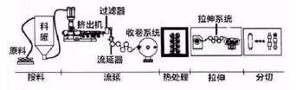
1. 基本概念 2. 关键技术路线 3. 磷酸铁锂优势4. 电性能及安全性能 5. 未来发展趋势及应用
Diaphragm-production process
The dry single drawing process is as follows:
1) feeding: the raw materials such as PE or PP and additives are pretreated according to the formula and transported to the extrusion system;
2) casting: the pretreated raw materials are extruded from the die head after melt plasticity, and the melt forms a base film with a specific crystal structure.
3) Heat treatment: the base film is obtained after heat treatment.
4) drawing: the hard elastic film is cold drawn and hot drawn to form nano-microporous film;
5) split cutting: the nano-microporous film is cut into finished film according to the requirements of customers.
The dry double drawing process is as follows:
1) feeding: the raw materials such as PP and pore forming agent are pretreated according to the formula and transported to the extrusion system;
2) casting: the PP casting sheet with high β crystal content and good homogeneity of β crystal morphology is obtained; 3) Longitudinal drawing: the casting sheet can be stretched longitudinally at a certain temperature, and the hole is easily formed by the tensile stress of β crystal.
4) Transverse tension: at higher temperature, the sample is stretched transversely to expand the hole and improve the uniformity of pore barrier size distribution.
5) setting rewinding: by heat treatment of diaphragm at high temperature, the thermal shrinkage of diaphragm is reduced and the dimensional stability is improved.

Slide 29
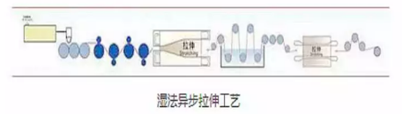


1. 基本概念 2. 关键技术路线 3. 磷酸铁锂优势4. 电性能及安全性能 5. 未来发展趋势及应用
Diaphragm - Production process.
the wet-process asynchronous drawing process flow is as follows:
1) feeding: pre-treating the raw materials such as PE, pore-forming agent and the like according to the formula to the extrusion system.
2) casting: the pretreated raw material is melted and plasticized in a double-screw rod extrusion system, the melt is extruded from a die head, and the melt is delayed to form a casting thick sheet containing a pore-forming agent through a flow.
3) Longitudinal stretching: the cast thick sheet is stretched in the longitudinal direction. And
4) transverse stretching: transversely stretching the longitudinally-stretched cast thick sheet to obtain a base film containing a pore-forming agent. And
5) extracting: the base film is formed without a pore-forming agent after the base film is solvent-extracted. And
6) setting, drying and shaping the base film which does not contain the pore-forming agent to obtain the nano-microporous membrane. And
7) cutting, cutting the nano microporous film into a finished film according to the specification requirements of the client.
Wet synchronous drawing: the technical process is basically the same as the asynchronous drawing technology, but can be oriented in both horizontal and longitudinal directions at the same time, eliminating the process of longitudinal stretching alone, enhancing the uniformity of diaphragm thickness. But the problem of synchronous drawing is that the speed is slow, the second is that the tunability is slightly poor, only the transverse drawing ratio is adjustable, and the longitudinal drawing ratio is fixed.

Slide 30
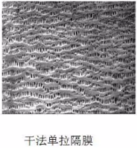
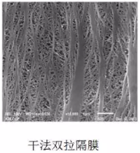
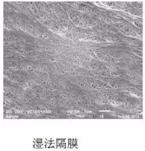
1. 基本概念 2. 关键技术路线 3. 磷酸铁锂优势4. 电性能及安全性能 5. 未来发展趋势及应用
Diaphragm classification
The pore morphology, pore uniformity and preparation process of diaphragm can be observed intuitively by scanning electron microscope (SEM). Scanning electron microscope (SEM) can reflect the uneven pore formation, tensile fracture and uneven coating of diaphragm.

Slide 31
1. 基本概念 2. 关键技术路线 3. 磷酸铁锂优势4. 电性能及安全性能 5. 未来发展趋势及应用
Diaphragm-coated diaphragm
type | the coating laye | characteristic
ceramic coated separato | High-heat-resistant inorganic ceramic particles such as Al2O3, SiO2, Mg (OH)2 | Improve the high temperature resistance, heat resistance and shrinkage of diaphragm and puncture strength. Good infiltration and liquid retention ability with electrolyte and positive and negative electrode materials Neutralize a small amount of hydrofluoric acid in the electrolyte to prevent battery inflation
PVDF coated membrane | Kynoa（PVDF） | It has excellent chemical resistance, high temperature resistance, oxidation resistance, flexibility and high tensile strength and impact resistance. It has the characteristics of low internal resistance, high (thickness/ void ratio) uniformity, chemical and electrochemical stability 3. Due to the presence of nanofibres, so that the lithium battery electrode has better compatibility and adhesion to the lithium battery electrode,
Aramid coated diaphragm | aramid fibe | It has heat resistance above 400 and excellent fire and flame retardancy. Because of the high affinity of aramid resin to electrolyte, the diaphragm has good infiltration and liquid retention ability, and prolongs the cycle life of battery. Aramid resin with fillers can improve the oxidation resistance of diaphragm, and then achieve high potentialization, thus increasing energy density.

Slide 32
1. 基本概念 2. 关键技术路线 3. 磷酸铁锂优势4. 电性能及安全性能 5. 未来发展趋势及应用
Four key Materials-electrolyte
Electrolyte characteristics requirements:
1. High conductivity over a wide temperature range;.
2. The liquid range is wide, and it is liquid in the range of 80~100℃ under normal conditions;.
3. Good chemical stability, not reactive with active substance, current collector, diaphragm, etc.;
4. Good compatibility with electrode material, which can form a stable and effective passivation film;.
5. Good electrochemical stability and high decomposition voltage;.
6. Flash point, high ignition point, good safety.

Slide 33
1. 基本概念 2. 关键技术路线 3. 磷酸铁锂优势4. 电性能及安全性能 5. 未来发展趋势及应用
Composition of electrolyte
electrolyte
lithium salts
LiPF_{6、}LiBF₆
LiBOB、LiTFSI
LiFSI、LiPO₂F₂
dissolvant
acrbonic acid esters
carboxylic este
Fluoroeste
Fluoroeste
additive
film-forming additive anti-overcharging additive flame-retardant additive stabilizing additive
影响
容量
内阻
电压
高温
低温
倍率
寿命
安全

Slide 34
1. 基本概念 2. 关键技术路线 3. 磷酸铁锂优势4. 电性能及安全性能 5. 未来发展趋势及应用
electrolyte solvent selection
organic solvent selection criteria
The organic solvent should be lazy to the electrode, and there should be no electrochemical reaction with the positive and negative electrodes in the charge and discharge process of the battery, and the stability is good.
Organic solvents should have high dielectric constant and small viscosity to make lithium salt have high solubility and high conductivity.
The melting point is low, the boiling point is high, and the vapor is low, so that the working temperature range is wide.
The electrode has good compatibility with the electrode material, and the electrode can show excellent electrochemical performance in the electrolyte.
Battery cycle efficiency, cost, environmental factors and other considerations.
dissolvant | Common solvent characteristics
EC | High dielectric constant, strong ability to dissociate lithium salt, high viscosity, high density, high melting, high boiling point, good high temperature properties
DMC | The viscosity is the lowest, the melting point is slightly higher, but the boiling point is low, so the performance at room temperature is good, but the performance at high and low temperature is not ideal. The conductivity and wettability of carbonate solvent are the best. It is often used in volume type, multiplier type and cylindrical electrolyte.
EMC | The viscosity is only higher than DMC, the melting point is low (-55°C), the boiling point is (108°C), the low temperature performance is better, and the high temperature performance is taken into account. Electrical conductivity and wettability between DMC and DEC, often used in capacity type, rate type electrolyte.
DEC | The melting point (- 43 ℃) boiling point (126 ≤ 127 ℃) is only lower than that of EC,PC, at high temperature, and its conductivity and wettability are worse than those of DMC,EMC. It is often used in high temperature electrolyte.
PC | The dielectric constant is high, the ability to dissociate lithium salt is strong, the melting point (- 49 ℃) boiling point (242 ℃), the high and low temperature properties are taken into account, but the viscosity is on the high side, which is only lower than EC, which is not conducive to infiltration. When the content is large, it will have an effect on the cyclic properties of natural graphite.

Slide 35
1. 基本概念 2. 关键技术路线 3. 磷酸铁锂优势4. 电性能及安全性能 5. 未来发展趋势及应用
the type of the organic solvent in the electrolyte
product name | molecular formula | formula weight (g/mol) | dielectric constant E/(c/v.m) | viscosity η/(mPa*s)25℃ | melting point T/℃ | boiling pointT/℃ | density ρ/ (g*cm⁻³)20℃ | surface
Ethylene carbonate(EC) | C₃H₄O₃ | 88.06 | 89.6 | 1.86(40℃) | 36.4 | 238.0 | 1.3214 | white crystal
propylene carbonate（PC） | C₄H₆O₃ | 103.09 | 66.1 | 2.513 | -49 | 242 | 1.198 | transparency liquid
Dimethyl carbonate（DMC） | C₃H₆O₃ | 90.08 | 3.108 | 0.5805 | 4.6 | 90 | 1.0632 | transparency liquid
diethyl carbonate(DEC) | C₃H₁₀O₃ | 118.1 | 2.82 | 0.748 | -43 | 126.8 | 0.9693 | transparency liquid
Ethyl carbonate( EMC) | C₄H₈O₃ | 104.10 | 2.4 | 0.65 | -55 | 108 | 1.007 | transparency liquid
propylene carbonate(MPC) | C₅H₁₀O₃ | 118.13 | 2.8 | 0.78 | -43 | 130 | 0.98 | transparency liquid
γ-butyrolactone(GBL) | C₄H₆O₂ | 86.09 | 39.1 | 1.73 | -43.5 | 204.0 | 1.1254 | transparency liquid
Methyl formate(MF) | C₂H₄O₂ | 60.05 | 8.90 | 0.328 | -99 | 31.75 | 0.9664 | transparency liquid
Methyl formate(EF) | C₃H₆O₂ | 74.08 | 7.16 | 0.358 | -79.6 | 54.31 | 0.9153 | transparency liquid
Methyl acetate(MA) | C₃H₆O₂ | 74.08 | 6.68 | 0.364 | -98.1 | 56.3 | 0.9279 | transparency liquid
acetic acid Ethyl(EA) | C₄H₈O₂ | 88.11 | 6.02 | 0.426 | -84.0 | 77.1 | 0.8946 | transparency liquid
Ethyl propionate(EP) | C₅H₁₀O₂ | 102.1 | 5.65 | 0.502 | -73.8 | 99 | 0.8842 | transparency liquid
Methyl butyrate(MB) | C₅H₁₀O₂ | 102 | 5.5 | 0.6 | -84 | 103 | 0.98 | transparency liquid
Ethyl butyrate(EB) | C₆H₁₂O₂ | 116.16 | 5.10 | 0.613 | -98.0 | 121.6 | 0.8739 | transparency liquid

Slide 36
1. 基本概念 2. 关键技术路线 3. 磷酸铁锂优势4. 电性能及安全性能 5. 未来发展趋势及应用
Selection of electrolyte and Lithium Salt
Lithium salt selection criteria
1. The lithium salt has high solubility in the organic solvent, the association degree is small, and the lithium salt is easy to dissociate to ensure that the electrolyte has higher electrical conductivity;
2.the anion has higher oxidation and reduction stability, the stability is good in the electrolyte, and the reduction product is beneficial to the formation of the electrode passivation film;
3. has good environmental affinity, and the decomposition product is small in environmental pollution;
4.Is easy to prepare and purify, and has low production cost.
lithium salt species | advantage | disadvantage
LiBF₄ | The working temperature range is wide, the high temperature stability is good, and the low temperature performance is excellent. It can enhance the film forming ability of electrolyte to electrode and inhibit the corrosion of Al foil. | The ion conductivity is low, which has great limitations and is often used in combination with lithium salt with high conductivity.
LiPF₆ | having suitable solubility and higher ionic conductivity in a non-aqueous solvent; a stable passivation film can be formed on the surface of the Al foil current collector; a stable SEI film can be formed on the surface of the graphite electrode by the co-carbonate solvent | The thermal stability is poor, and the decomposition reaction is easy to absorb water and hydrolyze.
LiAsF₆ | The comprehensive performance is better. | Itundefineds too toxic.
LiClO₄ | The comprehensive performance is better. | Strong oxidation leads to low safety.
LiBOB | It has high conductivity, wide electrochemical window, good thermal stability and good cycle stability. It has passivation and protection effect on positive Al foil collector. | The solubility is low and it is almost insoluble in some solvents with low dielectric constant.
electrical conductivity：LiAsF₆>LiPF₆>LiClO₄>LiBF₄ oxidative resistance：LiAsF₆>LiPF₆>LiBF₄>LiClO₄ heat endurance：LiAsF₆>LiBF₄>LiClO₄>LiPF₆

Slide 37
1. 基本概念 2. 关键技术路线 3. 磷酸铁锂优势4. 电性能及安全性能 5. 未来发展趋势及应用
Electric core-process road map
Baking material
(1 day)
Positive polar homogenate (1 day)
Positive electrode coating
(1 day)
Positive roll pressure
(1 day)
Positive die-cutting
(1 day).
Positive pole selected film
(1 day)
Baking of positive electrodes
(2 days)
Negative electrode selection
(1 day)
Baking (1 day)
negative homogenate
(1 day)
Negative Coating (1 day)
negative roll pressure (1 day)
negative die cutting
(1 day)
negative plate baking
(2 days)
lamination
(1 day)
The manufacturing process and shell punching process of positive and negative electrodes can be carried out side by side.
Aluminum plastic film
Shell impact
(1 day)
Suction seal
(1 day)
high temperature aging (1 day)
Form
(1.5 days)
Aging (exudate) (2 days)
Liquid injection (1 day)
Core baking
(3 days)
Core assembly (1 day)
High temperature hold (4 days)
Capacity (1 day)
Shelved at room temperature (14 days)
Group
(1 day)
Charge and discharge testing
(1 day)
Shell
(1 day)
Finished product testing (1 day)
Packing
(1 day)
Cumulative: 44.5 days unforeseen time (1.5 days) = 46 days;
when the single core needed for battery production is in stock, the production cycle of the battery pack begins with the core matching process, the production time is at least 7 days;
when the single core needed for battery pack production is a new product, the production cycle needs to be added to the production cycle, and the production time is at least 90 days.

Slide 38
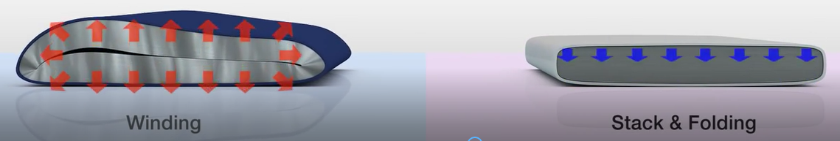
1. 基本概念 2. 关键技术路线 3. 磷酸铁锂优势4. 电性能及安全性能 5. 未来发展趋势及应用
Comparison of lamination and winding processes
Electric core structure | lamination | wind
Rate characteristic (internal resistance). | The rate is high and the internal resistance is low because each battery has a extreme ear | Low rate, high internal resistance (usually very few ears).
Capacity density | Make good use of it | Slightly smaller, due to the position at the arc
Battery deformation | Not easy to deform | Easy to deform, and deformation internal inconsistency, polarization inconsistency lithium analysis (hidden danger of safety)
Battery life | Not easy to deform and stable in performance | Because the deformation is inconsistent, the life span is slightly lower.
production efficiency | Slightly lower (low lamination speed) | High (automation, winding speed)
suit | Thick, thin battery | thin cell
Application | High power (HEV, PHEV, EV). | General PHEV,EV

Slide 39
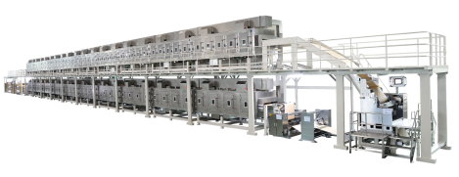
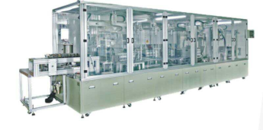
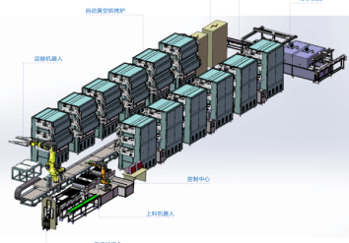
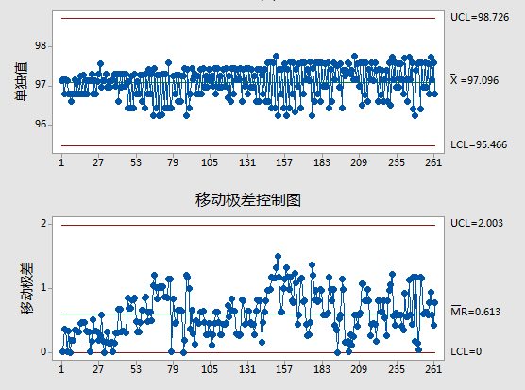
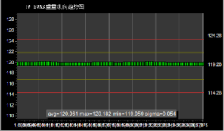
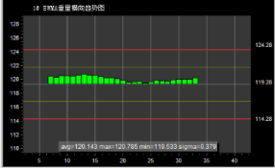
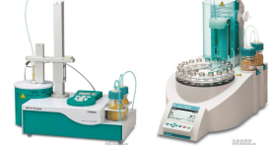
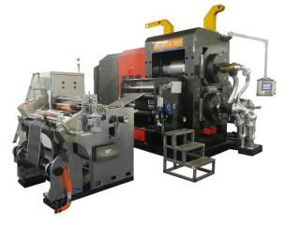
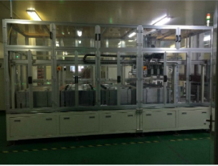
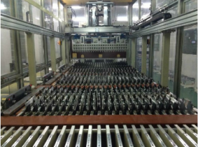
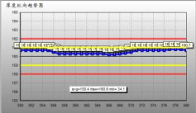
1. 基本概念 2. 关键技术路线 3. 磷酸铁锂优势4. 电性能及安全性能 5. 未来发展趋势及应用
Electric core-process road map
Automatic process in the era of Industrial 4.0
The on-line laser thickness gauge monitors the roll thickness and controls the roll press adjustment closed-loop. Ensure the consistency of compaction density.
The soft packaging battery adopts high temperature pressure forming process to form dense SEI film, which has higher capacity, better safety performance and longer life.
Coating consistency
Compaction density consistency
Strict moisture control
Advanced forming process
quantity of control liquid
High speed and high precision extrusion coating machine double frame and three ray surface density tester on-line monitoring surface density and closed-loop control. Ensure that the coating surface density is controlled within 1.2%.
Automatic high vacuum baking line to improve baking consistency and baking efficiency, reduce the moisture content in the core.
Using automatic liquid injection machine and automatic vacuum packaging line, the liquid injection and liquid loss of each core are monitored, and the liquid retention of each core is guaranteed by process adjustment.

Slide 40
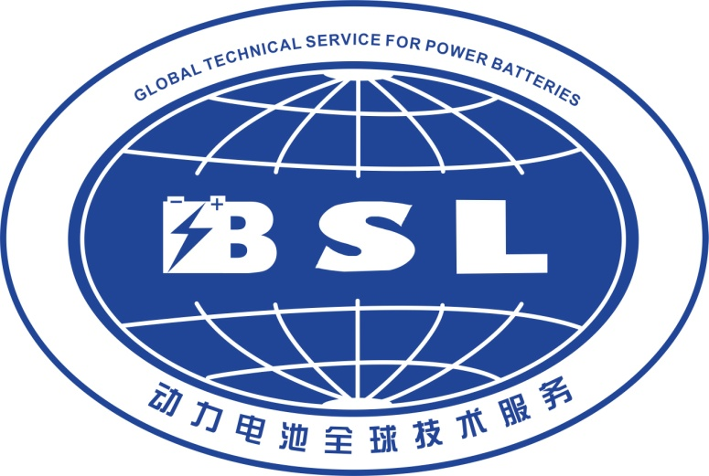
1. 基本概念 2. 关键技术路线 3. 磷酸铁锂优势4. 电性能及安全性能 5. 未来发展趋势及应用
catalogue：
1.Basic concept of Lithium Ion Battery
2. Key technical route of light power battery
2.1. Electric core-four main materials and process route 2.2. PACK-Key process and technical route
3. 磷酸铁锂优势
4. 磷酸铁锂电性能及安全性能
5. 轻型动力未来发展趋势及应用
Notes:
我的汇报分如下五个部分

Slide 41







1. 基本概念 2. 关键技术路线 3. 磷酸铁锂优势4. 电性能及安全性能 5. 未来发展趋势及应用
PCAK—Product application development path
Product application development path
protect/BMS
电芯/配组
container
battery
Adapting to different models
Parallel connection: constant voltage, increased capacity
Series: constant capacity, increased voltage
accessories

Slide 42






















1. 基本概念 2. 关键技术路线 3. 磷酸铁锂优势4. 电性能及安全性能 5. 未来发展趋势及应用
PCAK—Key process flow
Guide plate preloading
Protective plate processing
Electric core sorting
Polar ear cutting
Core tear film
cell thickness
Wire harness welding
Full inspection of welding spot
laser beam welding
Wear bracket, flatten
Electric core into shell
Shell glue filling
1differential pressure test
Wire harness finishing
welding spot gluing
volume test
Finished product testing
Top cover glue
pack
Finished product in box
Laser Code
Appearance check, label
Air tightness detection
upper cover ultrasound

Slide 43
1. 基本概念 2. 关键技术路线 3. 磷酸铁锂优势4. 电性能及安全性能 5. 未来发展趋势及应用
PCAK—Key process parameters
group process parameters
project | reference standard | remarks
volume @25℃±3℃ | Capacity difference, such as ≤ C ≤ 1% rated capacity
quantity of electricity | The quantity of electricity is determined according to different process, such as 5%,30%,70% etc.
differential pressure | Group pressure difference within a group, such as V ≤ 5mv
internal resistance | such as≤3mΩ
Constant current ratio | such as≥90%
K value | ≤0.004mv/h
Note: The matching group process may select several combinations of the above factors to group. Other factors may also be considered.
48 V12Ah capacity test process parameters
number | Type of work department | constant current （mA） | constant voltage （mV） | voltage limit （mV） | Current limit （mA） | Capacity limits （mAh） | time slicing
 |  |  |  |  |  |  | （hh:mm:ss）
1 | stewing |  |  |  |  |  | 0:00:10
2 | CC-CVcharge | 6000 | 53950 |  | 250 |  | 4:00:00
3 | stewing |  |  |  |  |  | 0:10:00
4 | CCcharge | 4000 |  | 57200 |  |  | 0:20:00
5 | stewing |  |  |  |  |  | 0:10:00
6 | constant-current discharge | 6000 |  | 35100 |  |  | 3:00:00
7 | stewing |  |  |  |  |  | 0:10:00
8 | CC-CVcharge | 6000 | 53950 |  | 250 | 8750 | 4:00:00
Detection and protection board overcharge protection
Detection and protection board overdischarge protection

Slide 44



1. 基本概念 2. 关键技术路线 3. 磷酸铁锂优势4. 电性能及安全性能 5. 未来发展趋势及应用
PCAK—Main welding methods
1
2
3
超声焊接
电阻焊接
激光焊
Surface welding, small internal resistance
The heating of welding process is small, and the surface will not oxidize after welding.
Have good adaptability to slight pollution or deformation
disadvantage
welding effect
advantage
Need double-sided tightening, low efficiency, not suitable for battery group, generally used in soft package nickel and other processes.
resistance
1
2
3
welding effect
Fast welding speed
Positioning requirements are not high
Simple fixture design
disadvantage
advantage
The surface welding can not be realized, and the internal resistance is high. It is generally used for cylindrical welding.
Welding process mode
lase
1
2
3
disadvantage
welding effect
Fast welding speed
non-contact welding
linear continuous welding
Higher smoothness of welding surface requires higher cleanliness of welding materials and higher heat generation in welding process is generally used in soft package serial welding.
advantage

Slide 45



1. 基本概念 2. 关键技术路线 3. 磷酸铁锂优势4. 电性能及安全性能 5. 未来发展趋势及应用
PCAK—Typical products in the market
model | 4812
Rated output voltage | 48V
Rated input/ output current | 2A/12A
nominal capacity | 12Ah
weight | ~4±0.5kg
cycle life | ≥600次national standard requirements
outline dimension | 252*140*70mm
model | 4820
Rated output voltage | 48V
Rated input/ output current | 4A/10A
nominal capacity | 20Ah
weight | 6.9±0.5kg
cycle life | ≥600次,national standard requirements
outline dimension | 300*200*90/250*180*125
model | 4820\6020\7220
Rated output voltage | 48V/60V/72V
Rated input/ output current | 4A/10A
nominal capacity | 20Ah
weight | 6.9±0.5kg/8.8±0.5kg/10.2±0.5kg
cycle life | ≥600次,national standard requirements
outline dimension | 180*155*255
model | 6020/7220（Tricycle）
Rated output voltage | 60V
Rated input/ output current | 8A/40A
nominal capacity | 40Ah
weight | 21.5±0.5kg
cycle life | ≥600次,national standard requirements
outline dimension | 350*200*270.5
智能电池

Slide 46



1. 基本概念 2. 关键技术路线 3. 磷酸铁锂优势4. 电性能及安全性能 5. 未来发展趋势及应用
PCAK—Introduction of protective board
Software protection board
General Protection：
security guard：
Overcharge, overdischarge, charging overcurrent, discharge overcurrent, cell overtemperature, MOS
overtemperature, low temperature protection, total voltage protection, ambient temperature protection, etc.
More than 20 kinds of protection
Charging MOS failure, discharge MOS failure, abnormal load, excessive temperature difference, anti-disassembly protection, short circuit protection, anti-theft, etc.
A
B
Hardware protection board
data type：
communication mode：
the total voltage, the total current, the monomer voltage, the battery temperature, the MOS temperature, the equilibrium temperature, the MOS switching state, the number of cycles, the equilibrium state, the number of cycles, the geographic information, the alarm information, and the like
Main features
More than a dozen data transfers
Multiple modes of communication
485 communication, UART communication, glimmer, remote upgrade, etc.
overcharge protection
overdischarge protection
overcurrent protection
short circuit protection
temperature protection
D
C

Slide 47

1. 基本概念 2. 关键技术路线 3. 磷酸铁锂优势4. 电性能及安全性能 5. 未来发展趋势及应用
PCAK—Working principle of protective board
Overcharge protection
1
过放控制MOS
过充控制MOS
electric amount
IC
project | typical paramete | remarks
Monomer overcharging protection voltage | 3.7V | Parameter adjustable
Delay time of single overcharge protection | 0.8~1.5S | Parameter adjustable
monomer overdischarge protection voltage | 2.3V | Parameter adjustable
monomer overdischarge protection delay time | 0.8~1.5S | Parameter adjustable
Permissible continuous discharge current | 1C | Parameter adjustable
Allowable maximum charging current | 0.5C | the same port
discharge overcurrent protection value | It is generally three times the rated current. | Disconnect load recovery
Sampling line breaking protection | have | Normal recovery of sampling line
short-circuit protection | have | Disconnect load recovery
Other functions | Design configuration according to requirements, such as remote GPS GPRS Bluetooth, etc.
Current
+
充电
-
STOP
4.2V
2
过放控制MOS
过充控制MOS
electric amount
IC
At this time, the charging MOS is opened and the charging is stopped.
Current
+
充电
-
Over-release protection
1
过放控制MOS
过充控制MOS
electric amount
IC
Current
+
放电
-
STOP
2
voltage
过放控制MOS
IC
过充控制MOS
2.8V
Current
放电
At this time, the discharge MOS is turned on and the discharge is stopped.
+
-

Slide 48






1. 基本概念 2. 关键技术路线 3. 磷酸铁锂优势4. 电性能及安全性能 5. 未来发展趋势及应用
PCAK—Charger and characteristics introduction

Slide 49








1. 基本概念 2. 关键技术路线 3. 磷酸铁锂优势4. 电性能及安全性能 5. 未来发展趋势及应用
PCAK—Introduction of Intelligent Battery
battery+management chip+bluetooth+transfe+gprs
Android and IOS System APP
Mobile phone scanning
install APP
Match with battery
GPS+GPRS\Bluetooth Smart
Data acquisition, positioning and tracking history track, data transmission
APP
Borrow and return batteries, scan power transmission, pay fees, data query
built in
internet
lithium battery
Remote client
Data query, intelligent alert. Track playback, supervision and management. Remote control, parameter configuration.
Cloud service
Data storage, core algorithm. Data Interconnection, Financial Payment.
Intelligent cloud battery
Application of Intelligent Battery Market
Smart Power Exchange
intelligent rent-lease

Slide 50



1. 基本概念 2. 关键技术路线 3. 磷酸铁锂优势4. 电性能及安全性能 5. 未来发展趋势及应用
PCAK—Rapid after-sales service system
current after-sales service system
User Discovery Issues
feed back to the whole car factory
Send local after-sales service staff
Remove the battery and return to the factory for repair
Battery loading use
10 major links
The period is about 30 days
1
2
3
4
5
6
7
8
9
10
feed back to the distributor
Notify the battery Supplier
Field battery testing
Return to the user after the repair
user care Return visit of satisfaction
IDBMS intelligent monitoring and early warning
fast speed to sell after dress affairs body system
Send local after-sales service staff
GPS+GPRS
Cloud platform
5 big links (4 intelligence) at least 24 hours in advance
1
2
3
4
5
Now locate the matching problem module
APP端
intelligent monitoring and early warning

Slide 51

Thank You
Yangxiaolin
2019/12/16
Notes:
我的汇报分如下五个部分

